Slide 1

Final Project Presentation:
Trader’s Diary
By: Paul Pezold & Yu Ji Chang

Slide 2


Business Context: Real World Scenario
Users create data in the form of entries and indirectly by their activities, which the parent app could use either to train or as inputs into their own machine learning tools.
User
This is profitable because it can lead to new insights in investment trader psychology and can help improve market predictions.

Slide 3
Project & Database Description
Purpose: For the customer, value is provided in that they can do market research, record their trading activities, and otherwise use the parent app’s features all in one location. The provider in turn receives valuable data.
Why it’s needed: Currently, there are many applications that allow you to trade, and others that allow you to market research. Some combine those features, but none that we are aware of provide those in addition to our diary feature in a user friendly package.
What it does: Allows the user to record diary entries about the trades they make, and allows them to do market research to inform those trades from one location

Slide 4
Project & Database Description
Purpose: For the customer, value is provided in that they can do market research, record their trading activities, and otherwise use the parent app’s features all in one location. The provider in turn receives valuable data.
Why it’s needed: Currently, there are many applications that allow you to trade, and others that allow you to market research. Some combine those features, but none that we are aware of provide those in addition to our diary feature in a user friendly package.
What it does: Allows the user to record diary entries about the trades they make, and allows them to do market research to inform those trades from one location

Slide 5
Project & Database Description
Purpose: For the customer, value is provided in that they can do market research, record their trading activities, and otherwise use the parent app’s features all in one location. The provider in turn receives valuable data.
Why it’s needed: Currently, there are many applications that allow you to trade, and others that allow you to market research. Some combine those features, but none that we are aware of provide those in addition to our diary feature in a user friendly package.
What it does: Allows the user to record diary entries about the trades they make, and allows them to do market research to inform those trades from one location

Slide 6
Project Description Continued
Input data available: Historical data on economic behavior, company behavior, and price fluctuations are easily available through from different vendors. This app combines them, and then also has contains the user generated text data about their trades.
Information stored: The historical data mentioned above is stored in the database, and a fully implemented application would have a way to pull in more relevant current information at a users request. All of the users metadata is stored, and linked to their transactions by foreign key
Notes:
Input data available: Historical data on economic behavior, company behavior, and price fluctuations are easily available through from different vendors. This app combines them, and then also has contains the user generated text data about their trades.

Slide 7
Project Description Continued
Input data available: Historical data on economic behavior, company behavior, and price fluctuations are easily available through from different vendors. This app combines them, and then also has contains the user generated text data about their trades.
Information stored: The historical data mentioned above is stored in the database, and a fully implemented application would have a way to pull in more relevant current information at a users request. All of the users metadata is stored, and linked to their transactions by foreign key

Slide 8
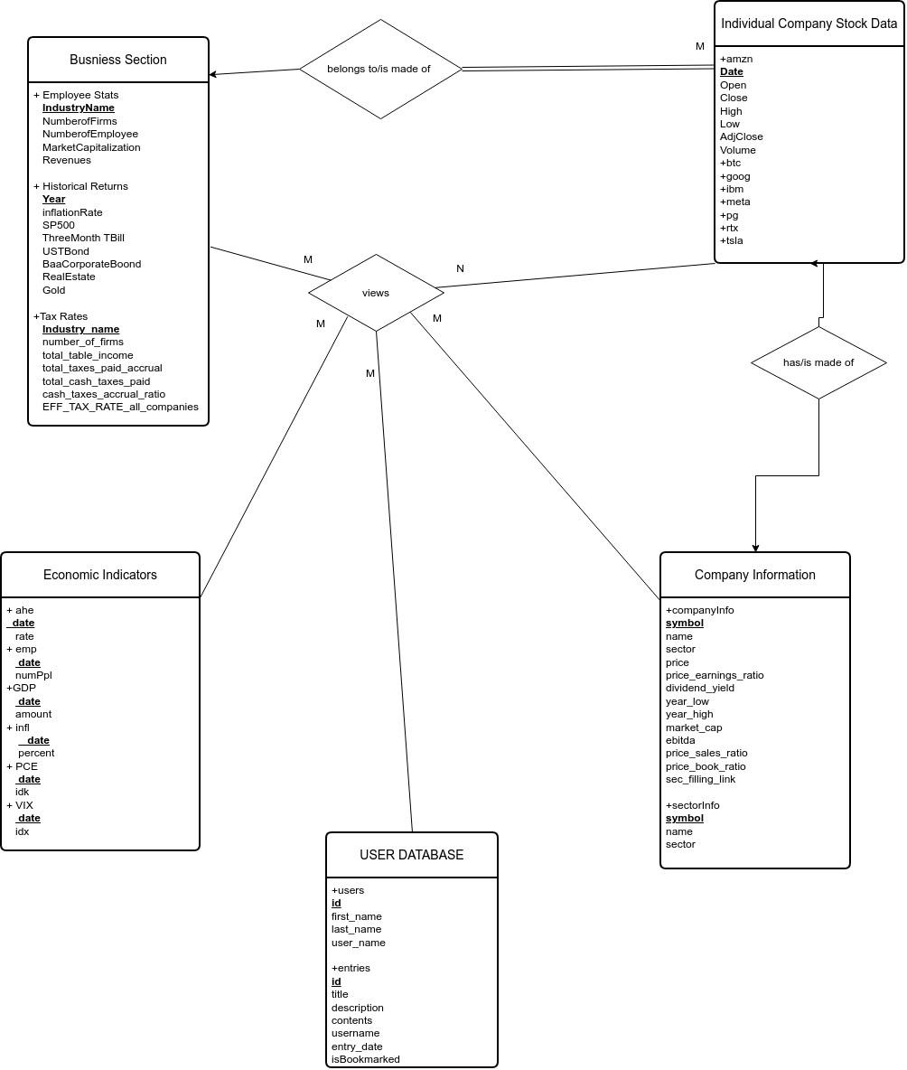
ER Diagram

Slide 9

UI Demonstration- Function Description

Slide 10
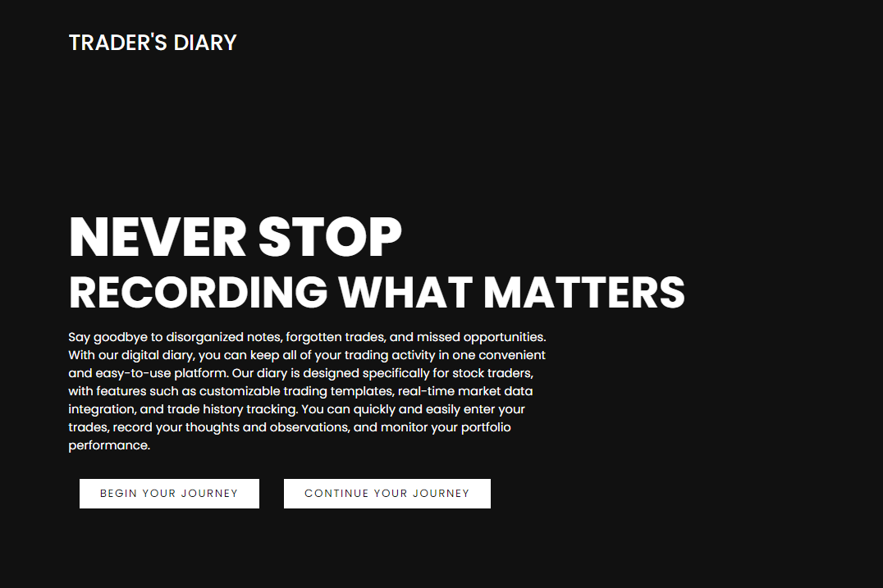
Front End- Landing Page

Slide 11
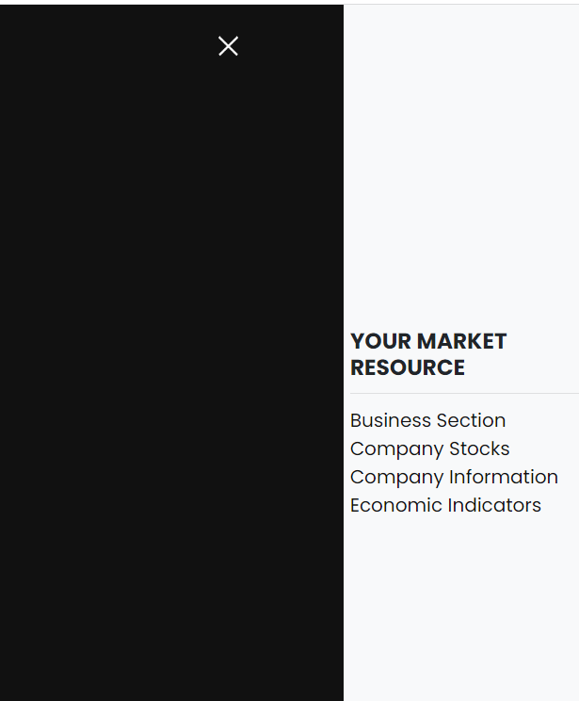
Market Resources

Slide 12
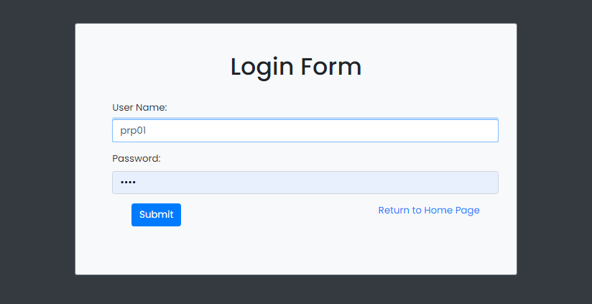
Log in

Slide 13
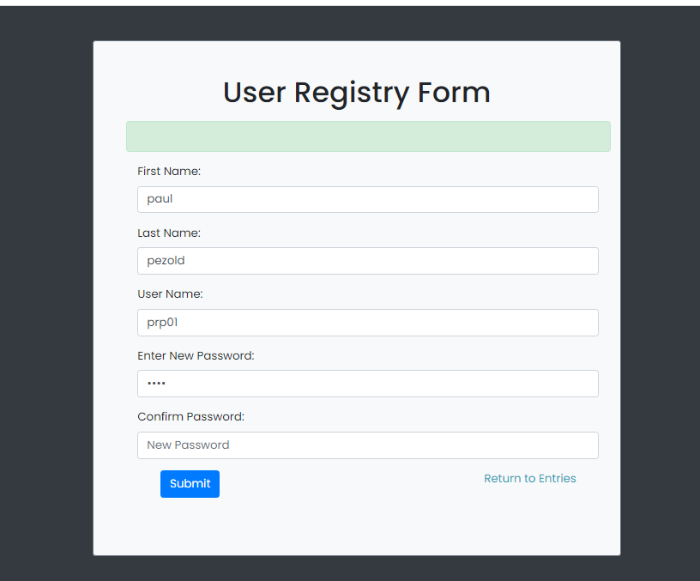
Update User Info

Slide 14
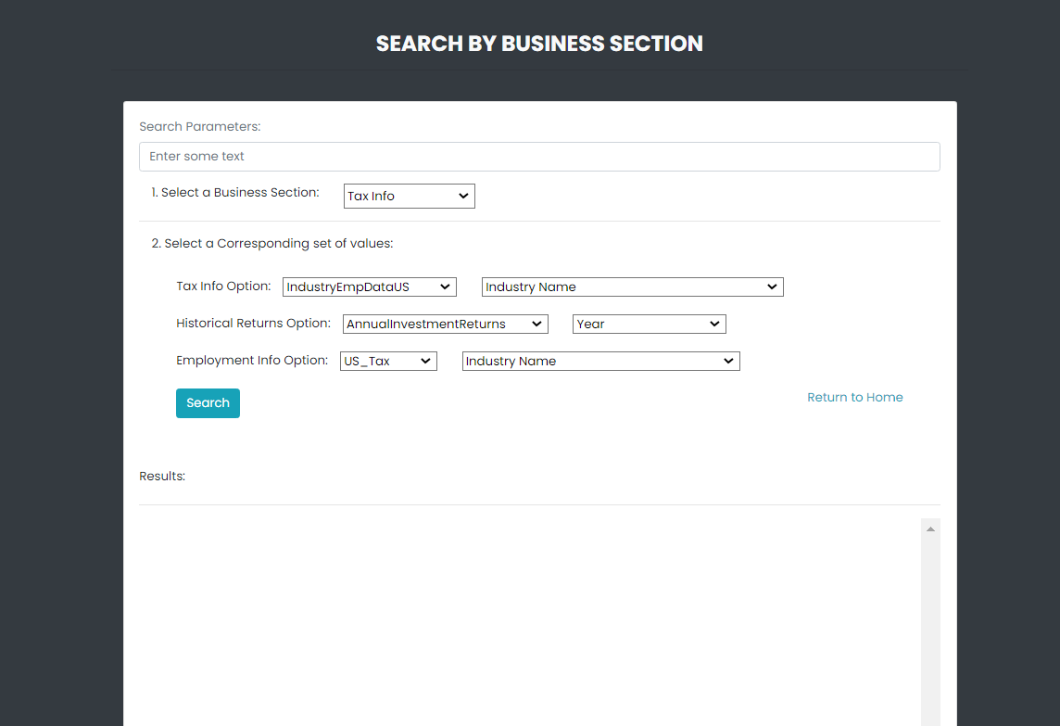
Search Market Data

Slide 15
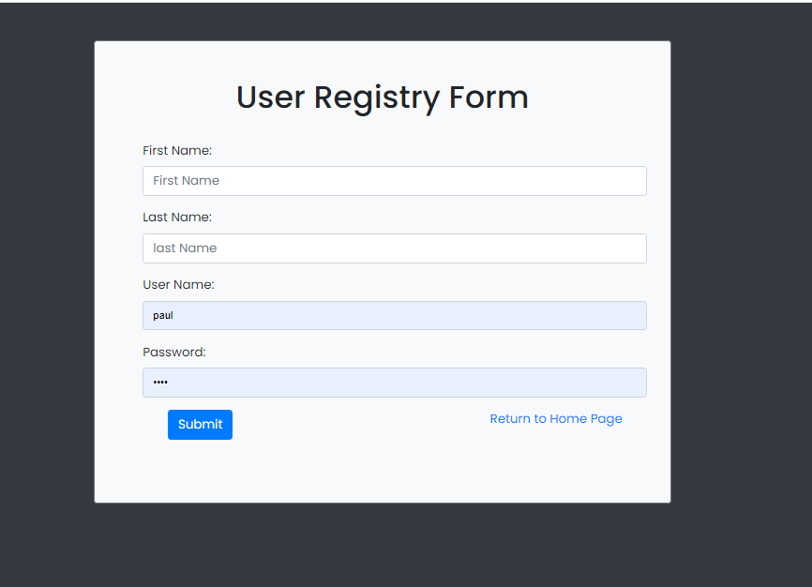
Register a User

Slide 16
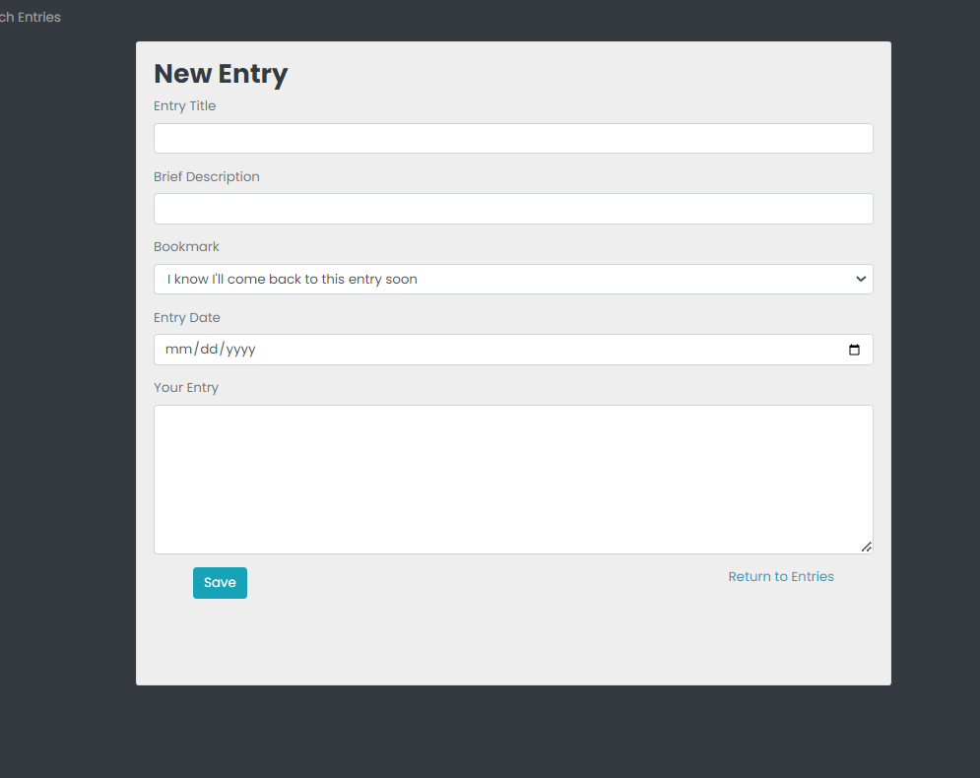
Create Diary Entry

Slide 17
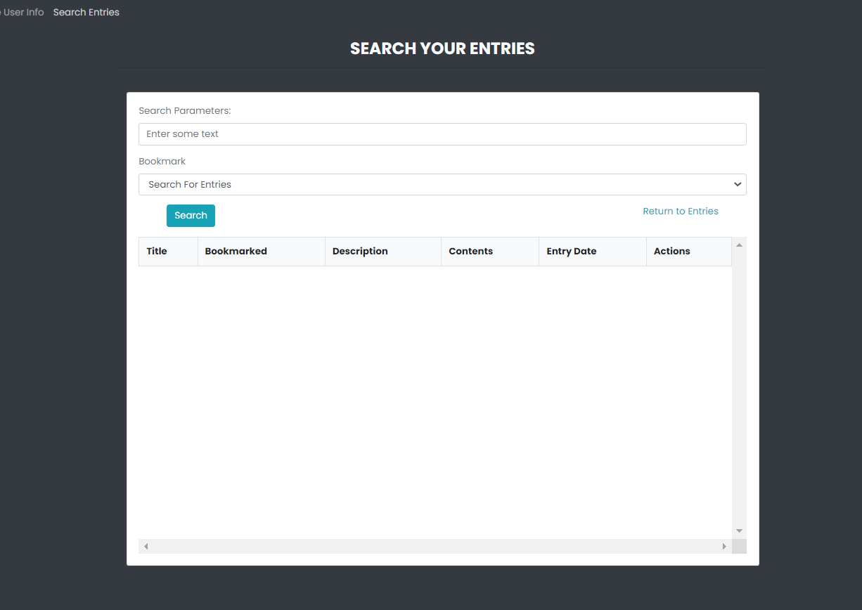
Search Your Diary Entries

Slide 18
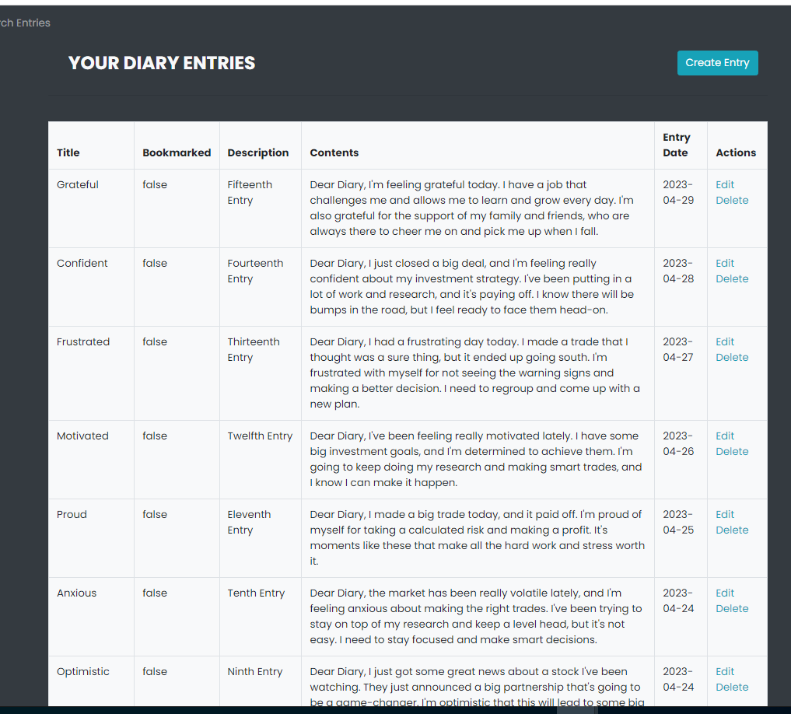
View Entries

Slide 19
Code Explanation

Slide 20
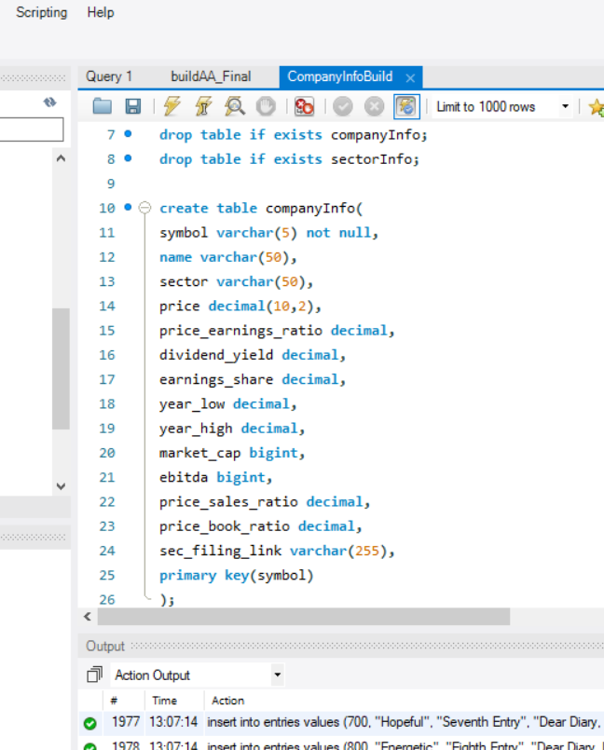
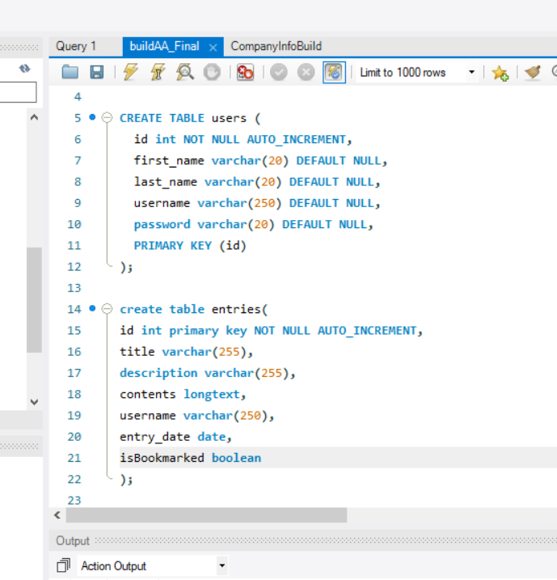
Code Snapshots- Building the tables

Slide 21
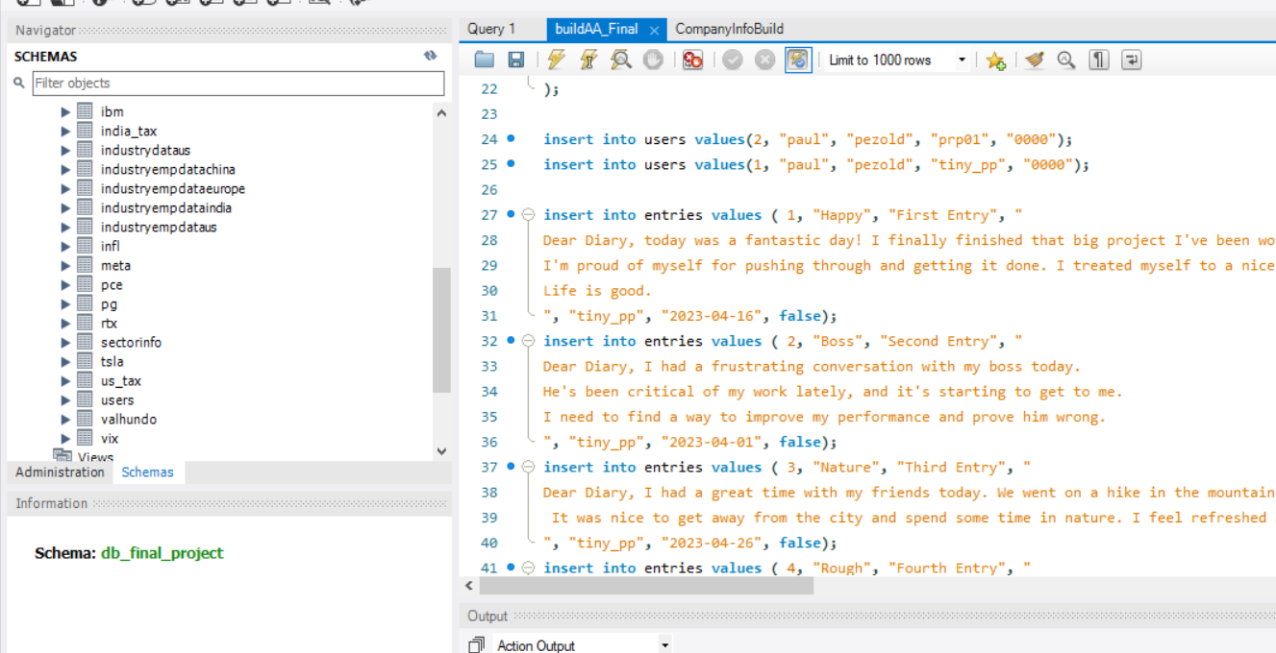
Getting Data

Slide 22
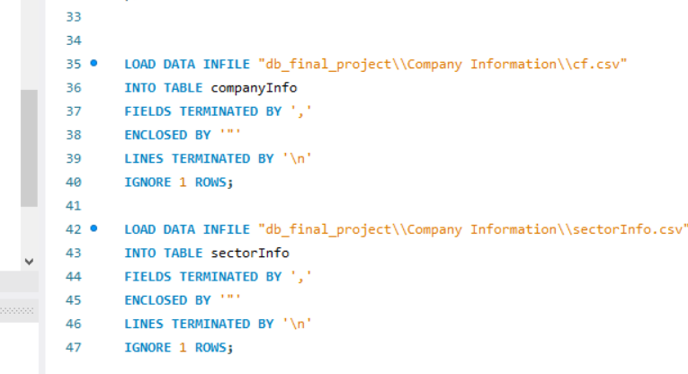
Note about installation
-If you try to install my files on your machine, you will have to configure your MySQL to allow data uploads. You will also need to configure the file path found at the bottom of each Market Section build file, LOAD INFILE “C//User…”

Slide 23
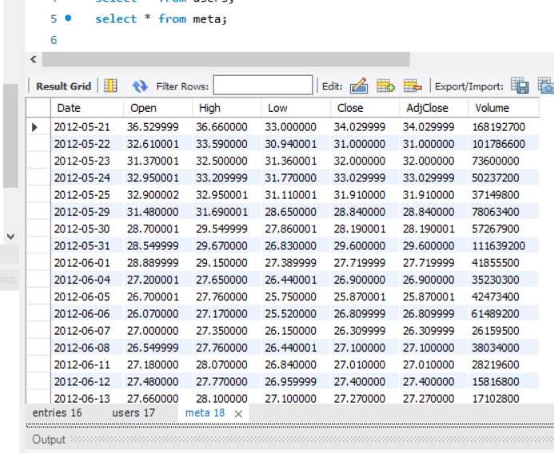
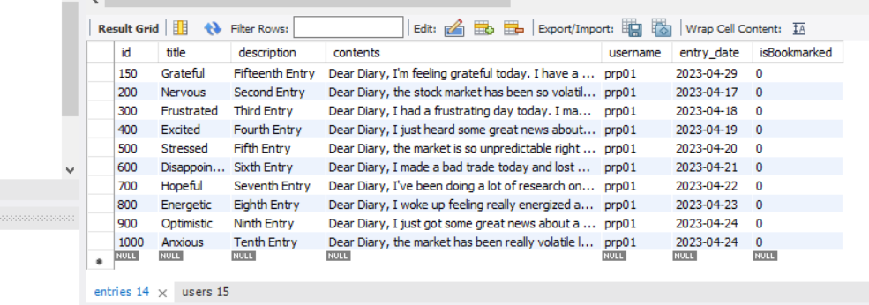
Some Table Screenshots

Slide 24
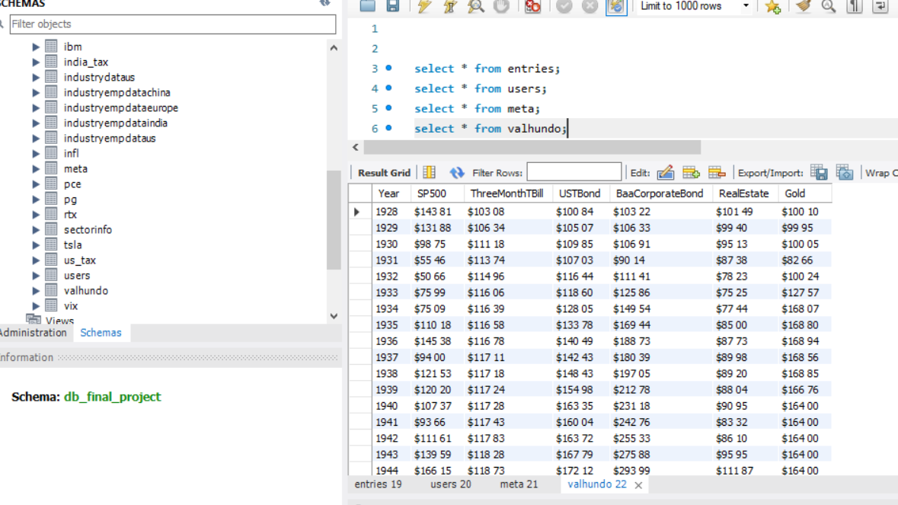

Slide 25
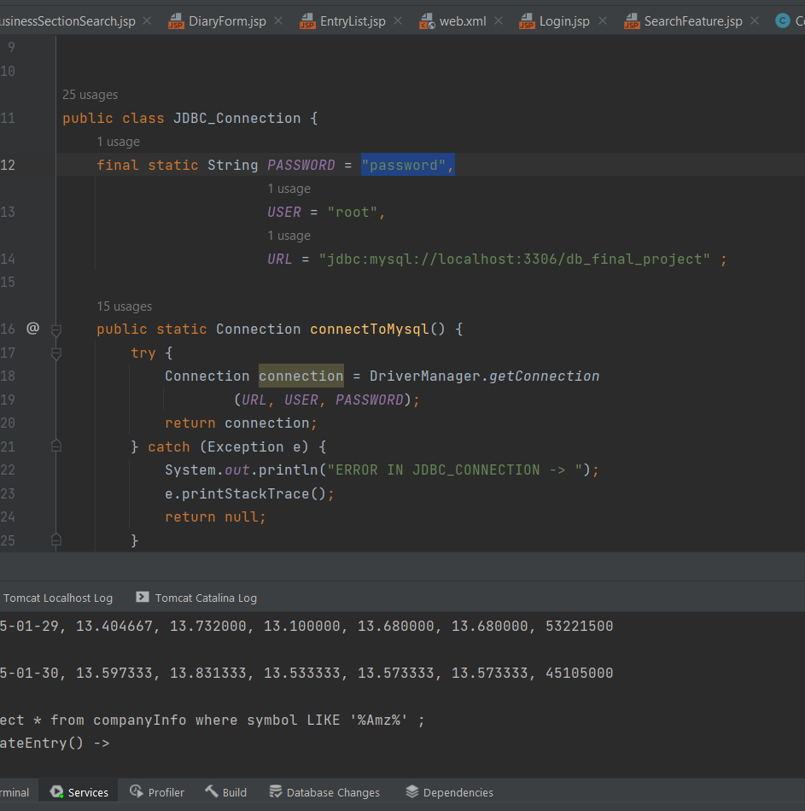
Connection

Slide 26

Querying the Database- Loose Coupling

Slide 27
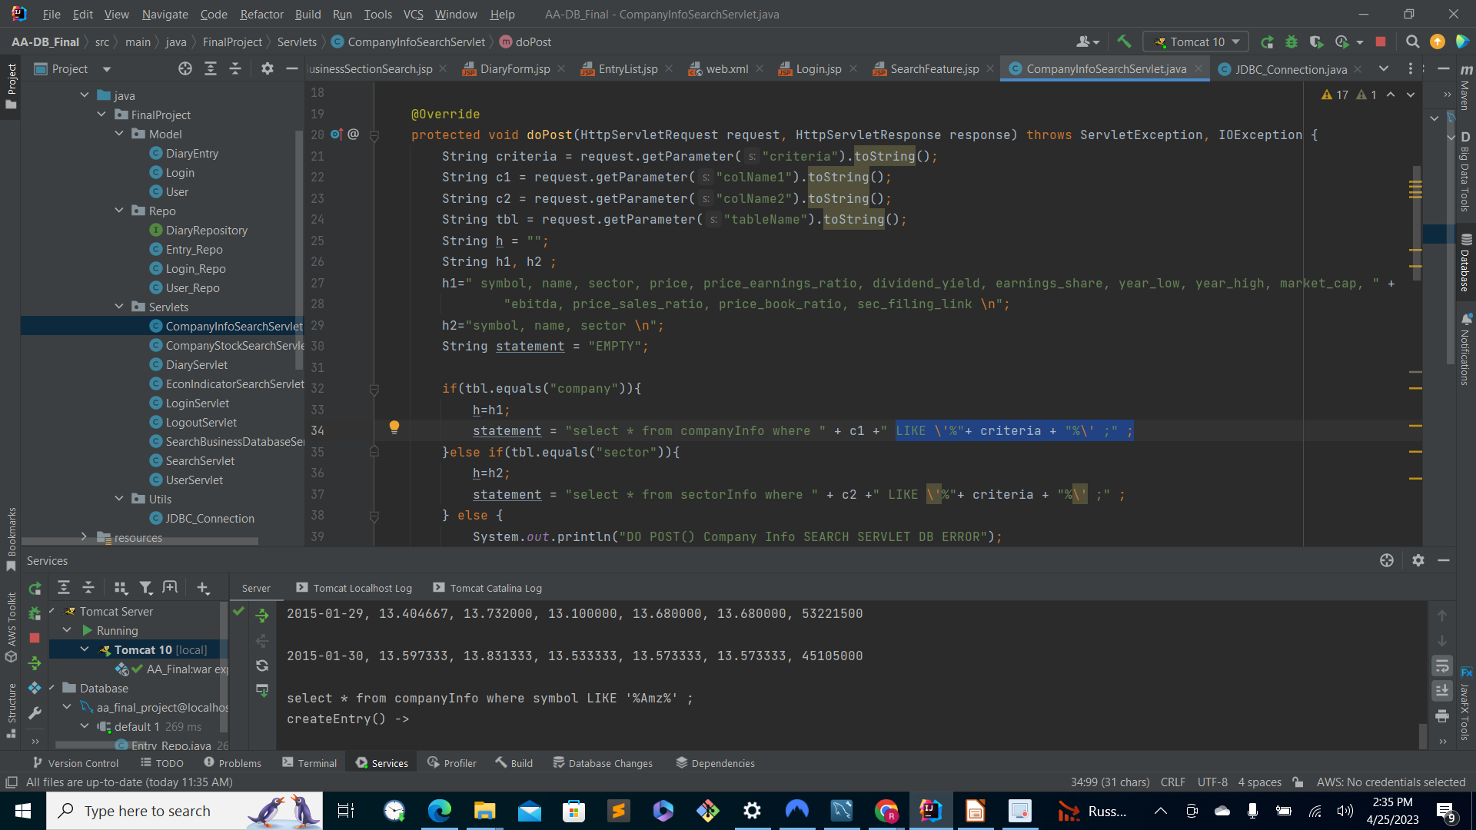
Controller- Servlets

Slide 28
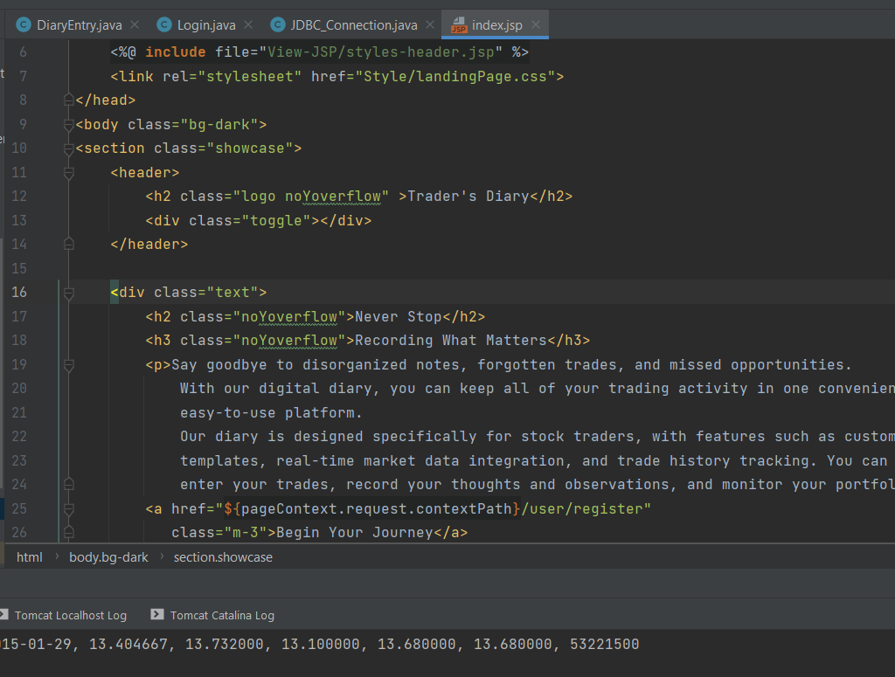
View- Jsp

Slide 29
Teamwork
-Paul had already developed the majority of the UI from a different project
- Yuji did brainstorming and handled creating diagrams, slides, etc.
- Both built and implemented the remaining parts of the database together
-Paul made the demonstration videos

